Slide 1



Offuture Performance Analysis
2011 – 2014
Team JOIN:
Egle ,
Aksha,
James,
Rachel

Slide 2

Agenda
Overview revenue and growth
What are the factors influencing revenue?
Which products performed the best? The worst?
Which market channel is the best for business?
Product profitability
Conclusions
Questions

Slide 3

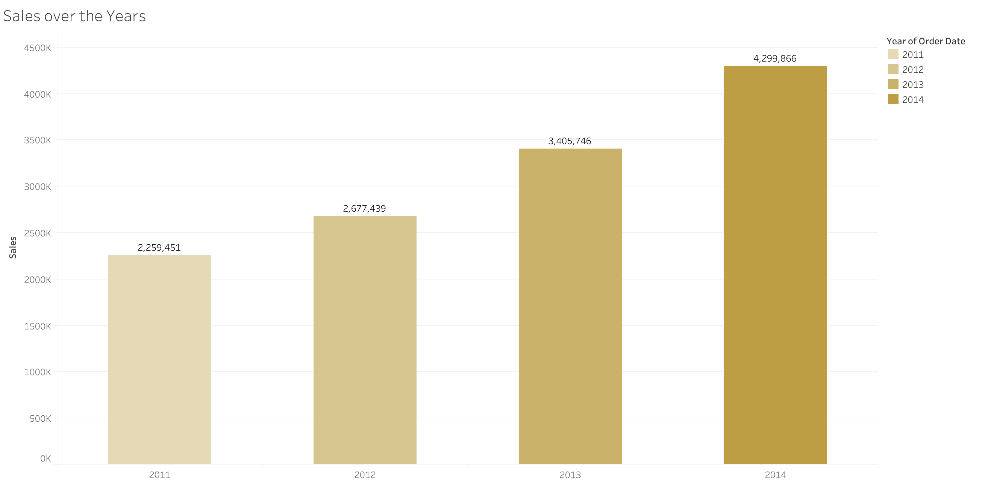
How did Offuture perform in terms of revenue?
26,3%
27,2%
18,5%
Photo by Brandi Redd on Unsplash
Notes:
The bar graph shows that the total sales increases over the years
Why is there this increase? - Do we have more customers? - Do we have more orders?

Slide 4
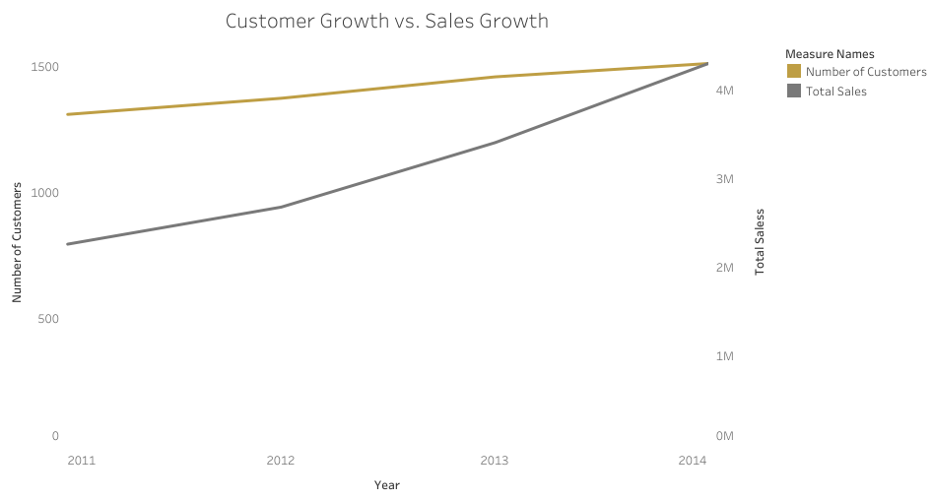
Have the number of customers increased?
Notes:
The graph here shows the increase in sales again (same as bar graph in previous slide but this time as line graph)
The number of customers has not increased as much
So again why has sales increased even though we've got the same number of customers?
(1) are they ordering more?
(2) are they spending more?

Slide 5
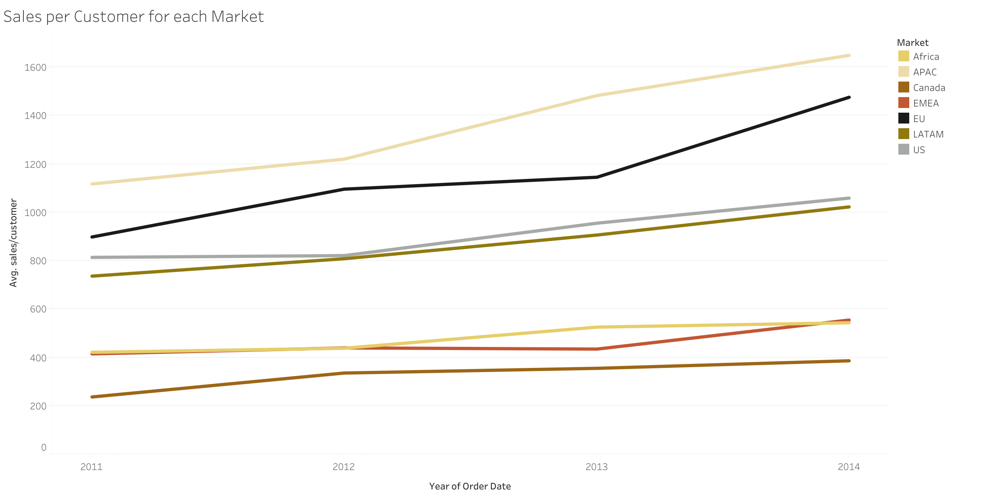
Are individual customers spending more over the years? Is it the same for each market?
Notes:
The numbers reference slide 4 notes
(1) Are the customers spending more? ---> YES
--we also separate by market to see if this is true across all markets or is there one particular one that skewing it

Slide 6
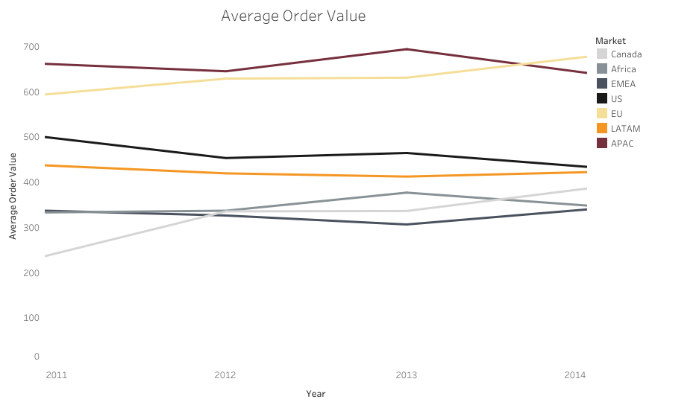
Spending More?
Notes:
The numbers reference slide 4 notes
(1) Are the customers spending more? ---> YES
--we also separate by market to see if this is true across all markets or is there one particular one that skewing it

Slide 7
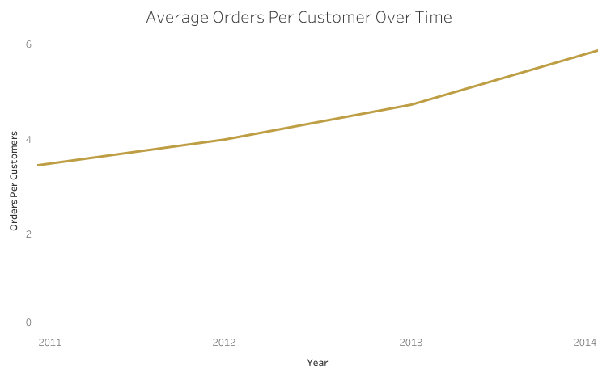
Ordering
More?
Notes:
The numbers reference slide 4 notes
(1) Are the customers spending more? ---> YES
--we also separate by market to see if this is true across all markets or is there one particular one that skewing it

Slide 8
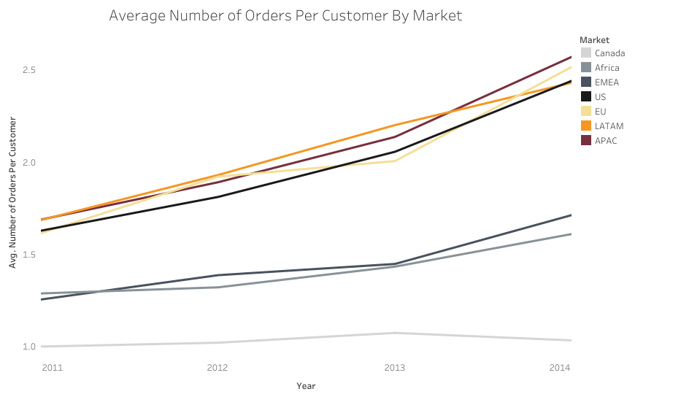
Ordering
More?
Notes:
The numbers reference slide 4 notes
(1) Are the customers spending more? ---> YES
--we also separate by market to see if this is true across all markets or is there one particular one that skewing it

Slide 9
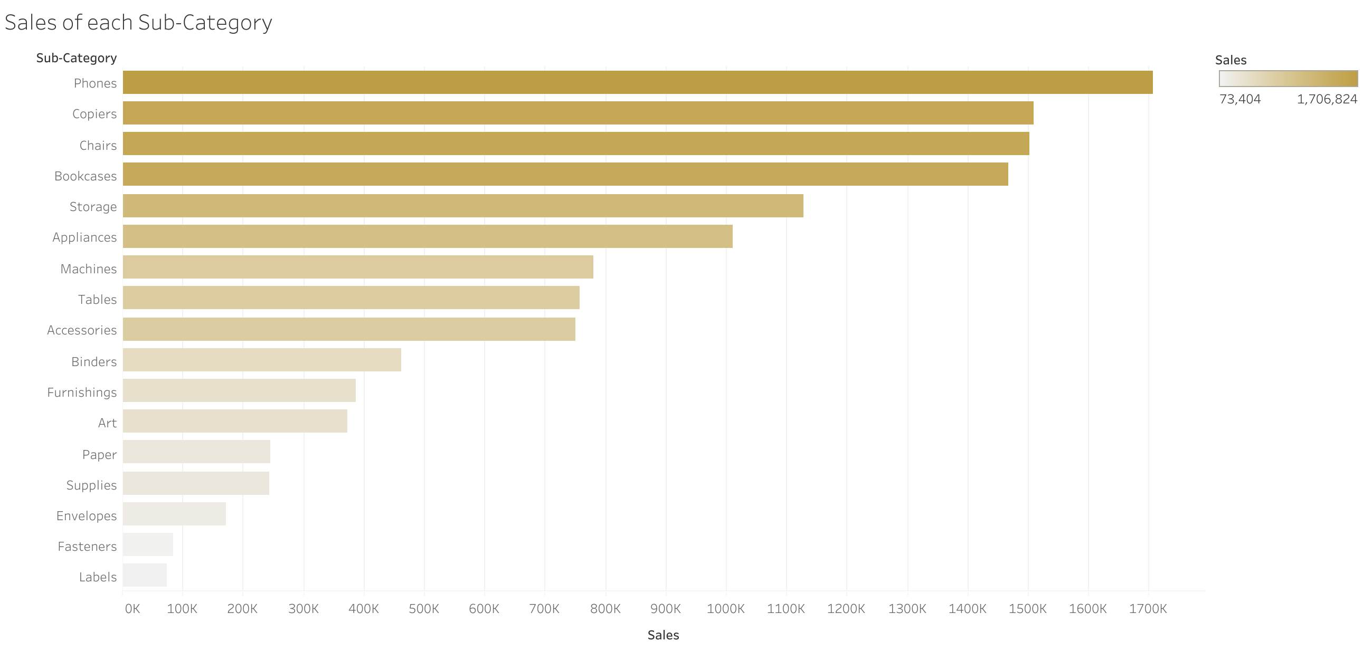
Which Products contribute to the Sales the most? The least?
Notes:
Which products are contributing to the increase in sales the most? --- we looked at subcategories
We see an increase in almost all of them
So again we ask is this true across all markets? (but we look at countries this time) --- question could be better in order to link to next slide:
Are all countries interested in the same products?
Which markets are contributing most to the sales?

Slide 10

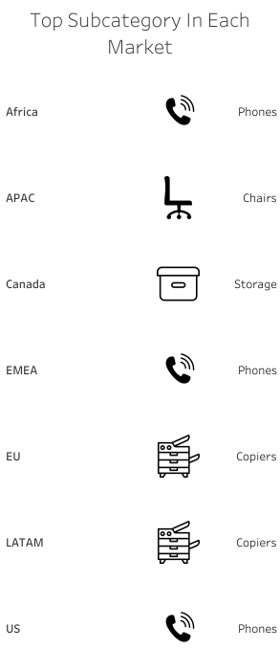
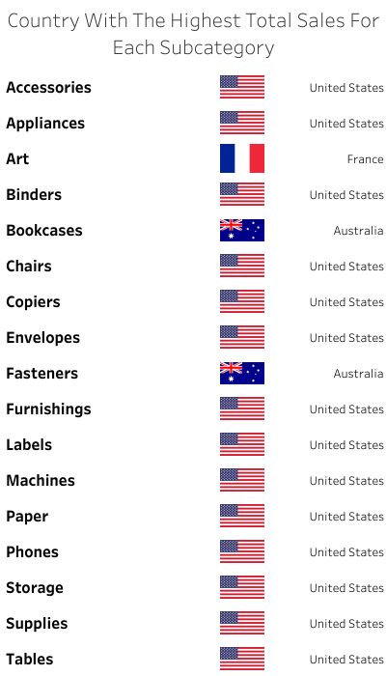
Is it the same everywhere?
Photo by Sarah Dorweiler on Unsplash
Notes:
Looking at which country is the top buyer (by sales $$$) in each subcategory
AND which sucategory made most sales in each market
We notice US spending a lot of money:
How much money has offuture gained (profit) due to US, compared to the rest?

Slide 11
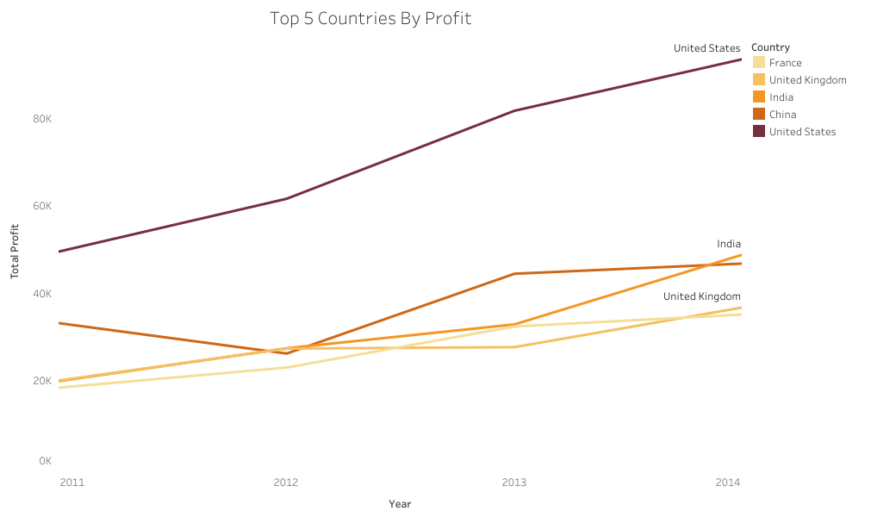
How much profit has been made by the US compared to rest?
Notes:
How much profit US has contributed to compared to the others? ---> a lot more
Is this true across all it states?

Slide 12
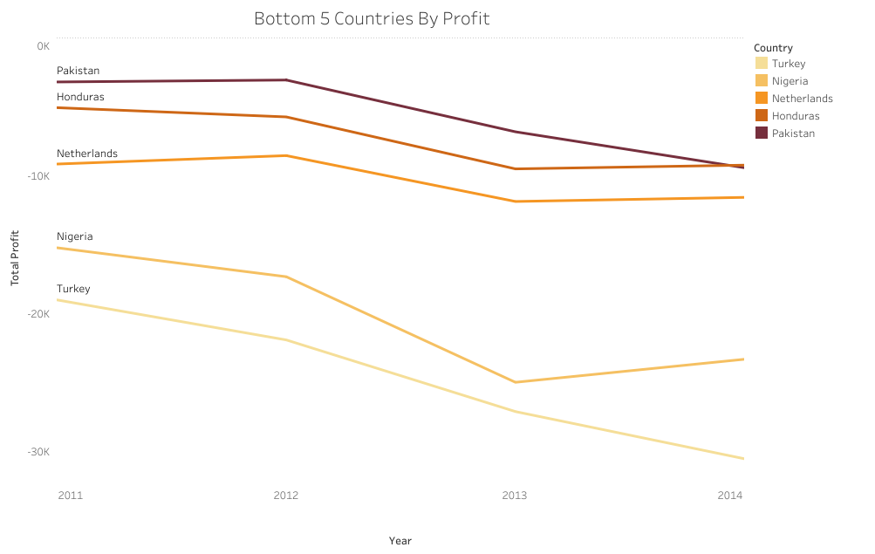
How much profit has been made by the US compared to rest?
Notes:
How much profit US has contributed to compared to the others? ---> a lot more
Is this true across all it states?

Slide 13
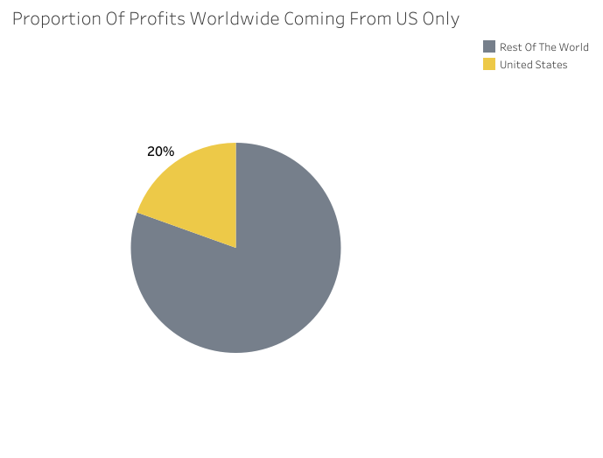
What proportion of profits are from the US?

Slide 14
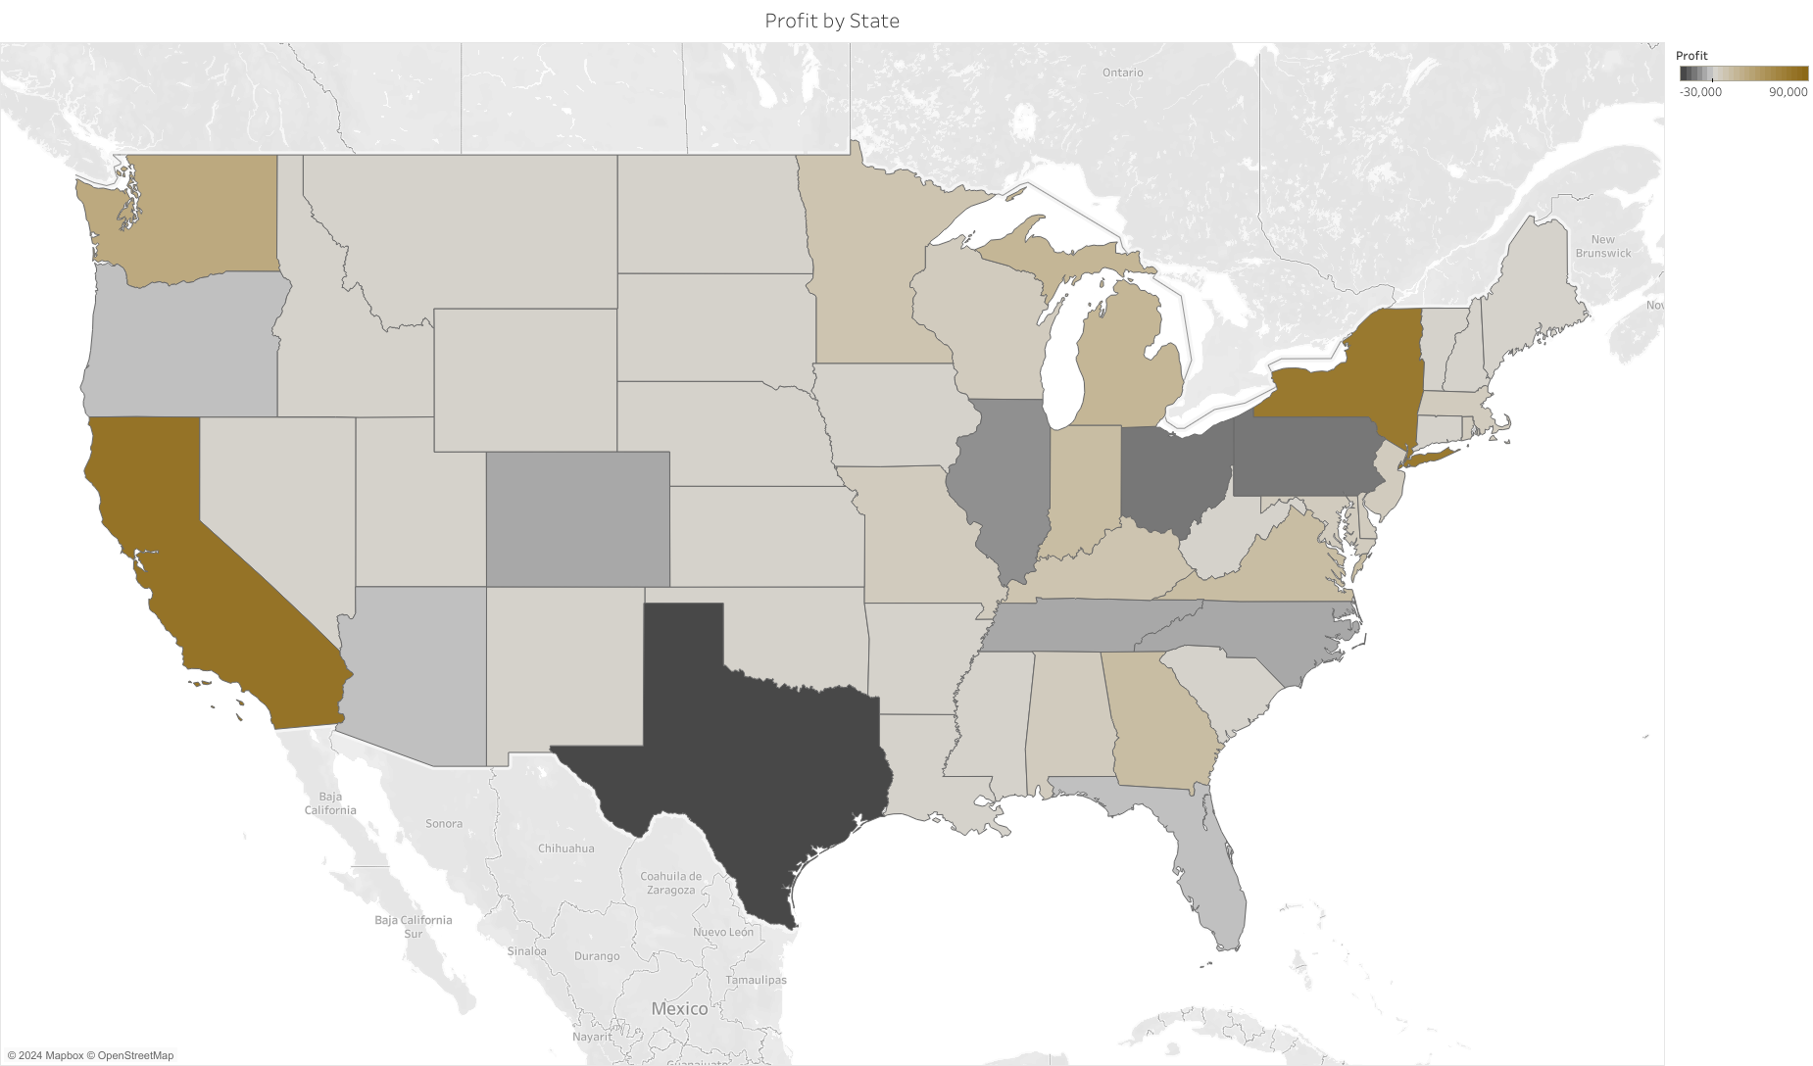
Is performance the same for all states?
Notes:
Do all US states give a 'nice' profit?
Suprisingly NO
There are quite a few (7) states who have negative profits every year – of which we've listed 5

Slide 15
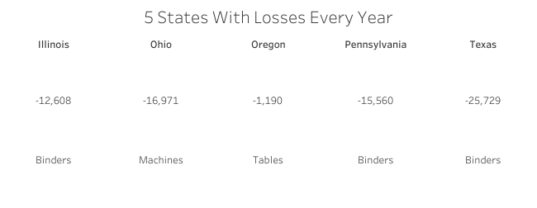
Which products are underperforming?
Notes:
Despite these losses, US is still the biggest contributor to the profit
Maybe it has to do with the products it bought ?? ---- don’t know if this is the right question
So we look at the profitability of products within each state.

Slide 16
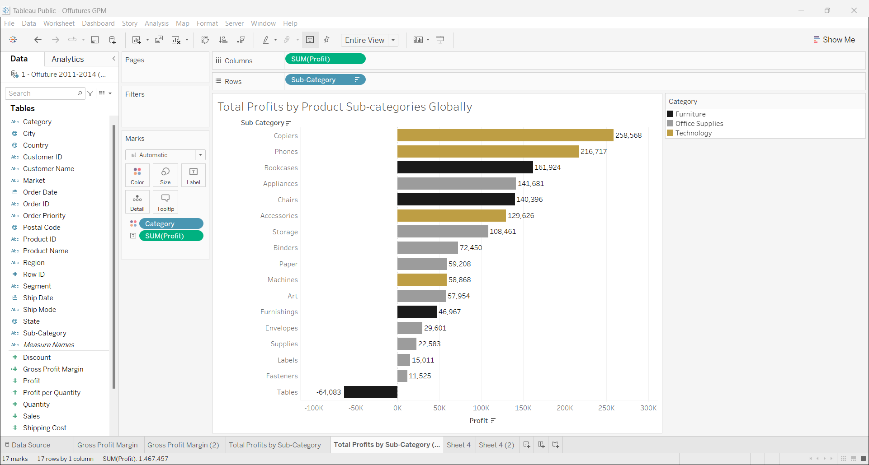
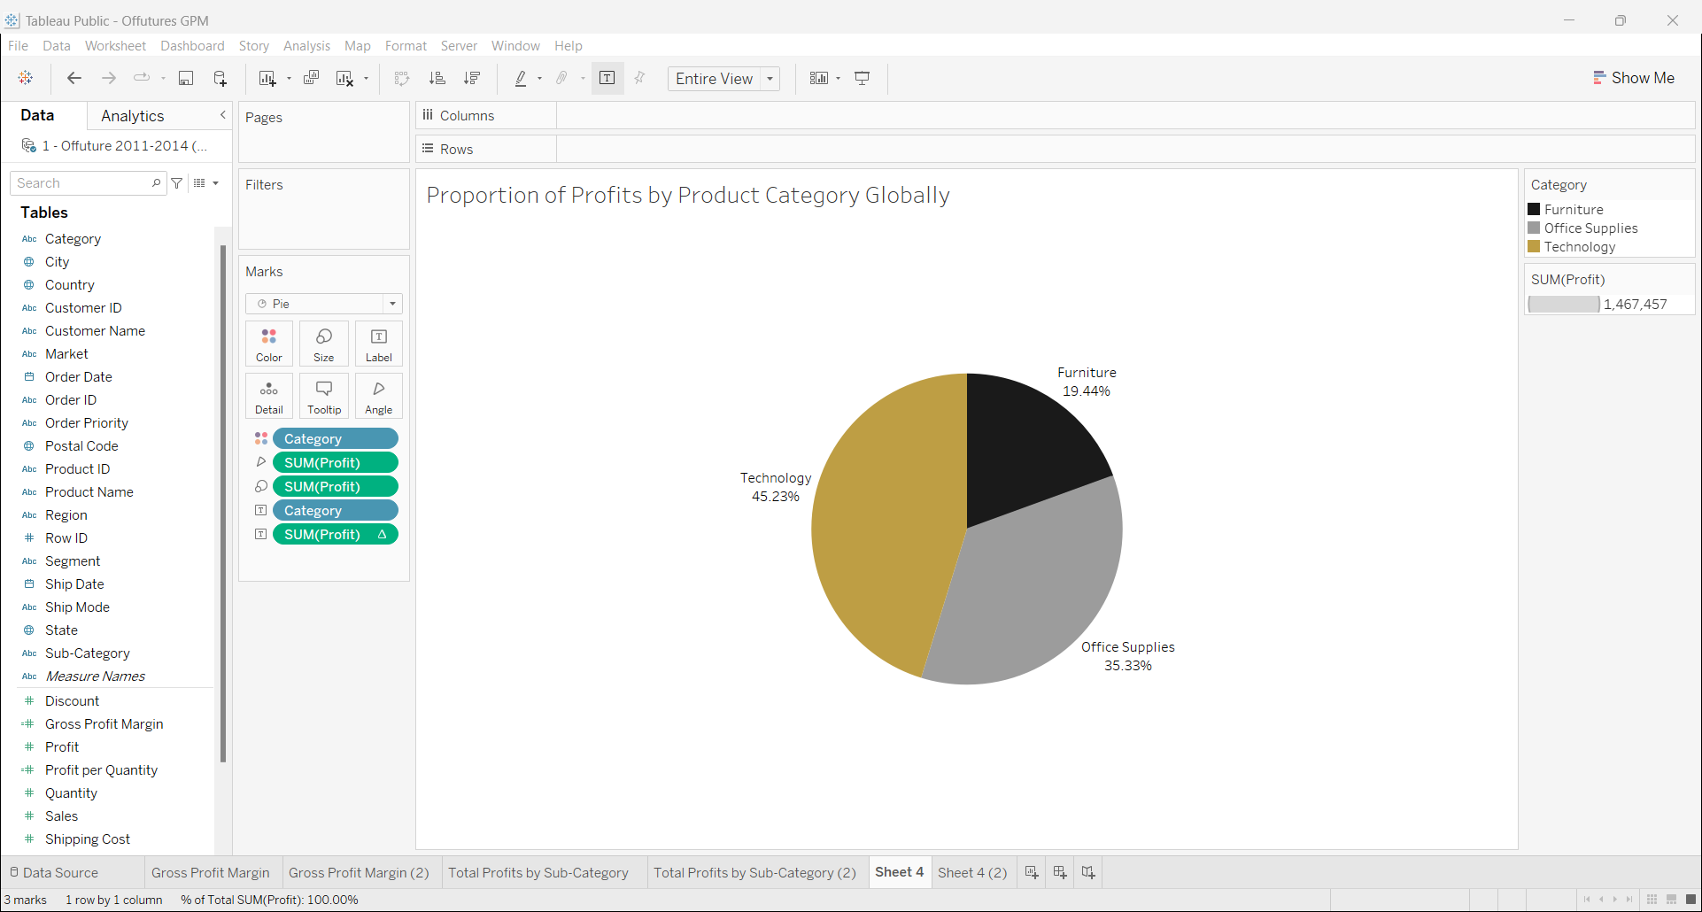
How well have these products done globally?
Notes:
Zooming out here to look at the profitability of the specified products in previous slide globally
The question leading to next slide would be: Have these products done the same globally?
--i.e are they still the most profitable when you look at the whole market?

Slide 17
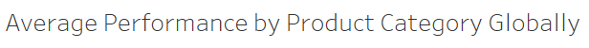
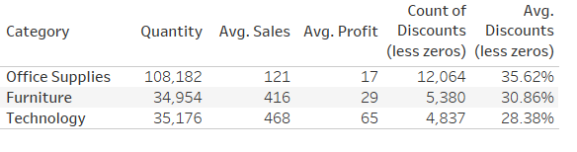
How well have these products done globally?
Notes:
Zooming out here to look at the profitability of the specified products in previous slide globally
The question leading to next slide would be: Have these products done the same globally?
--i.e are they still the most profitable when you look at the whole market?

Slide 18
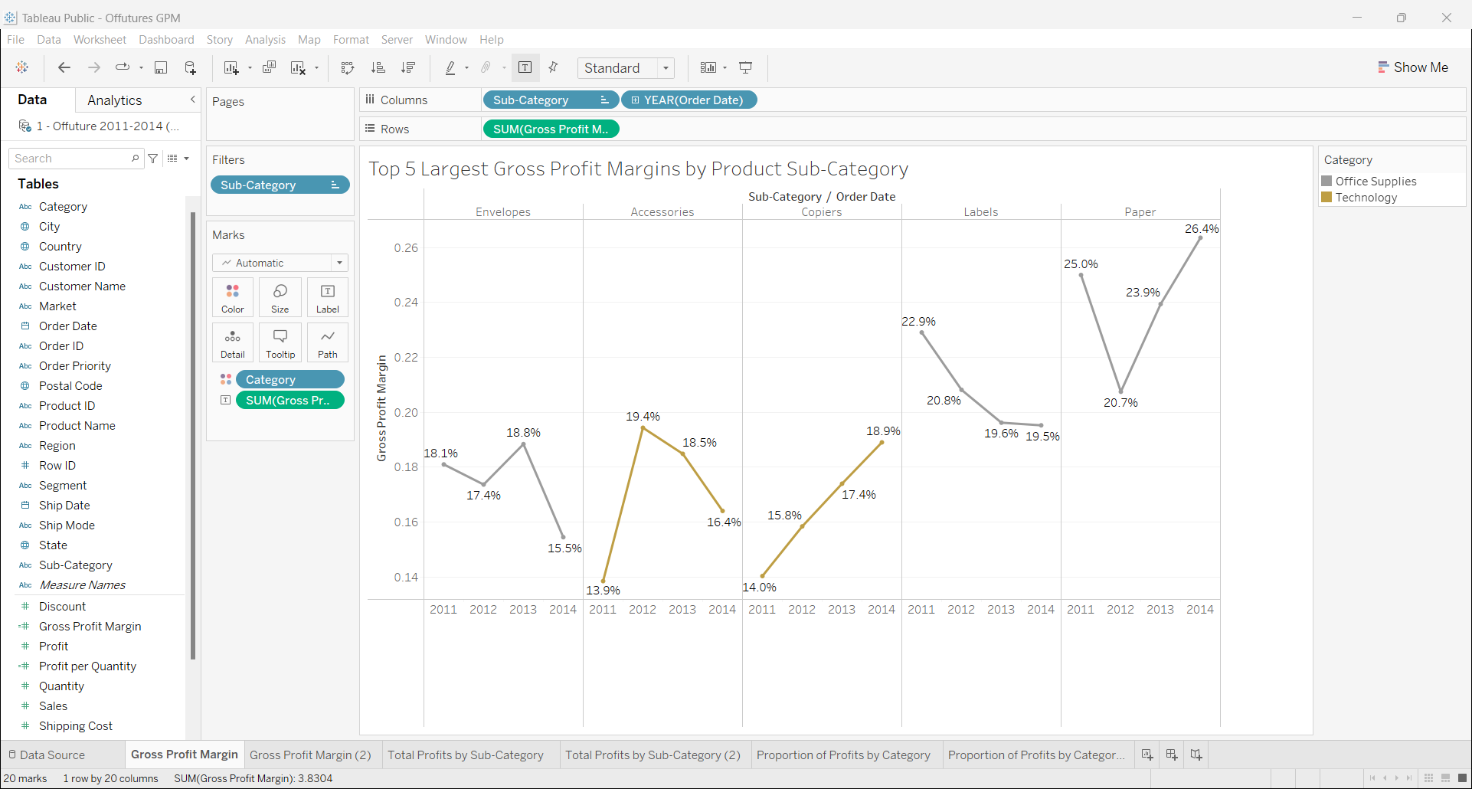
Which product provides the best margins?

Slide 19
Conclusion
Sales have increased overtime
Customers not so much: customers have ordered more over time
Technology products (phones, copiers) have performed the best in terms of sales
Almost all of the product sub-categories are generating the most money in the US in the global context
Office supplies (paper, labels) were the most profitable although didn’t not provide the most significant profits
Notes:
Summarise all our findings.

Slide 20
Any Questions?
Team JOIN:
Egle ,
Aksha,
James,
Rachel

